Slide 1




Slide 2


Slide 3


Slide 4


Slide 5


Slide 6








Slide 7



Slide 8



Notes:
Height: 0.29
Width: 0.58

Slide 9






























HOME

Slide 10


Slide 11





















Slide 12


Slide 13


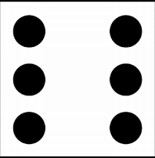




Slide 14


